Slide 1

STUDENT INFORMATION SYSTEM
TEAM 2:
-N100213, Janardhan P
-N100099, Kadhar Baba Sk
-N100269 Maha Lakshmi G
-N100475, Sandhya U
-N100755, Samuel Raju M

Slide 2
TABLE OF CONTENTS
Introduction
Non Functional Requirements
UML diagrams
Data Base Design
User Interfaces
Code Implementation
Conclusion

Slide 3
INTRODUCTION
The main aim of Student Information System (SIS) is to maintain students information in the university and to display details related to each student by authentication.
This applet application is useful to students to maintain their personal and academic information.
Other important feature is that a student can write their exams and soon after completion of the exam student will get their corresponding exam marks. Further we can assess and analyse the student performance.

Slide 4
NON FUNCTIONAL REQUIREMENTS
  TECHNOLOGIES USED:
  JAVA Applets
  JDBC Technology – JAVA Data Base Connection
  MySQL
  OPERATING SYSTEMS:
  Any operating system which has java runtime environment.
  Server should have a facility of MySQL server.
  HARDWARE REQUIREMENTS:
  Processor : Pentium, Processor i3
  RAM : 128 MB
  Hard Disk : 20GB

Slide 5
FUNCTIONAL REQUIREMENTS
Login and registration
Database schema
Students details
Sem Registration & Exam details
Results

Slide 6
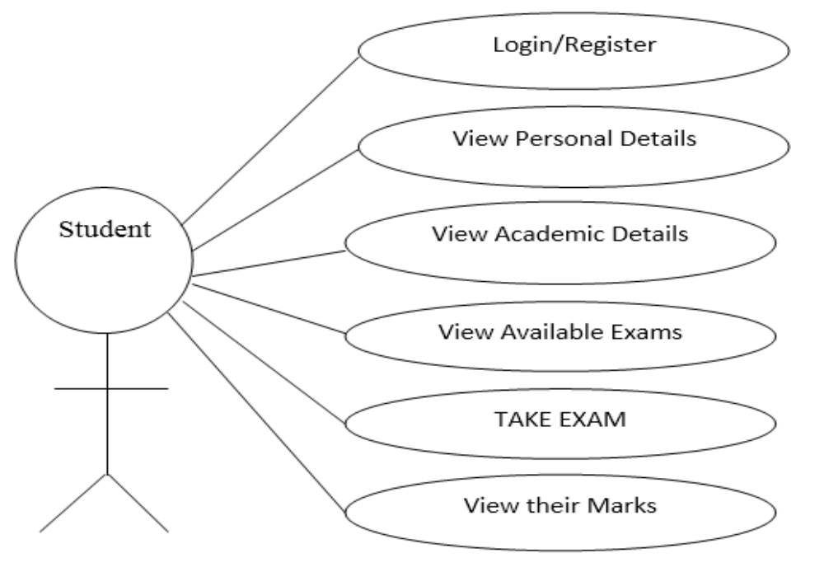
UML DIAGRAMS
Use case Diagram

Slide 7
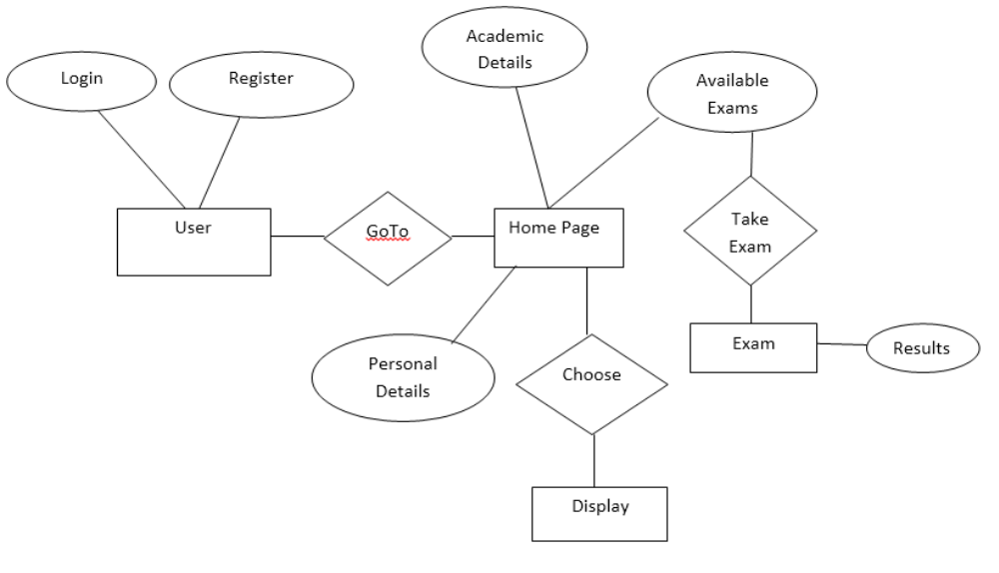
CONTD…
E-R Diagram

Slide 8
DATA BASE DESIGN
We create the following tables in SIS.
  User details
    idno varchar,name varchar,batch varchar,branch varchar,class varchar,dob varchar,email varchar,contact varchar,password varchar
  Course registration
    iddno varchar,course varchar,marks int,status tinyint
  Course Details
    CourseName varchar(20),ExamDate datetime,MarksGainded int(11),TotalMarks` int(11),status tinyint(1)
  Oops
    questions varchar,answer varchar(10),options varchar(30)
  Itw
  Cn
  Ai

Slide 9
CONTD...
EXAMPLE QUERIES:
select password from user_details where idno = '"+nameText.getText()+";
select a.CourseName,a.ExamDate,b.marks,a.TotalMarks,b.status from course_details a,course_registration b where b.iddno='"+hm.userId+"' and a.CourseName = b.course;
update course_registration set marks = "+marks+",status = 1 where iddno='"+hm.userId+"' and course ='"+course+";

Slide 10
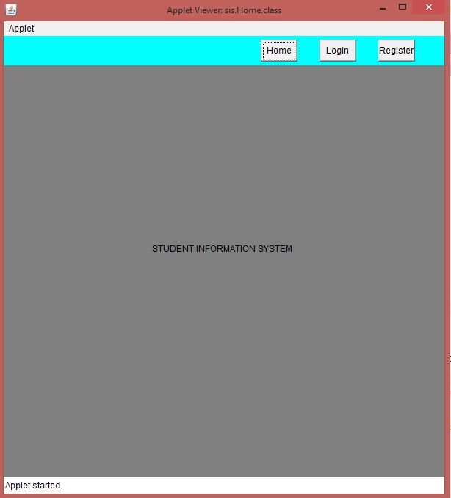
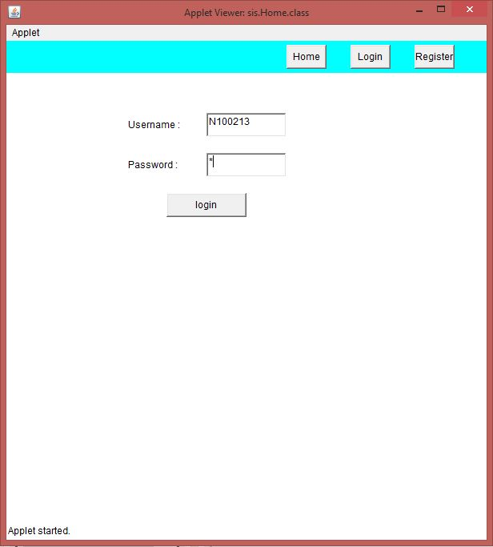
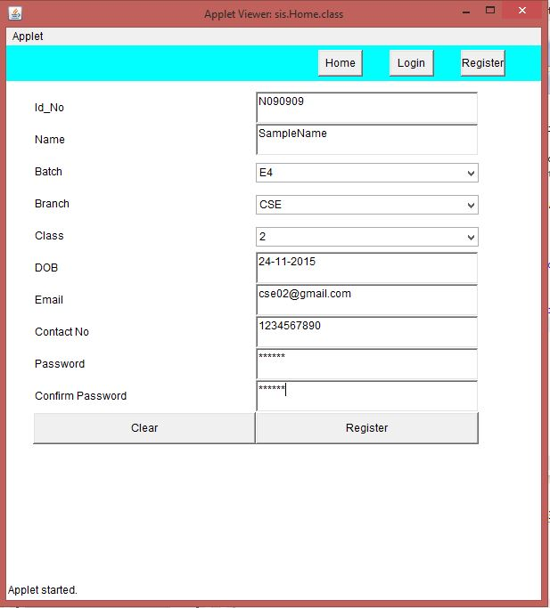
USER INTERFACE
Login and Registration Forms

Slide 11
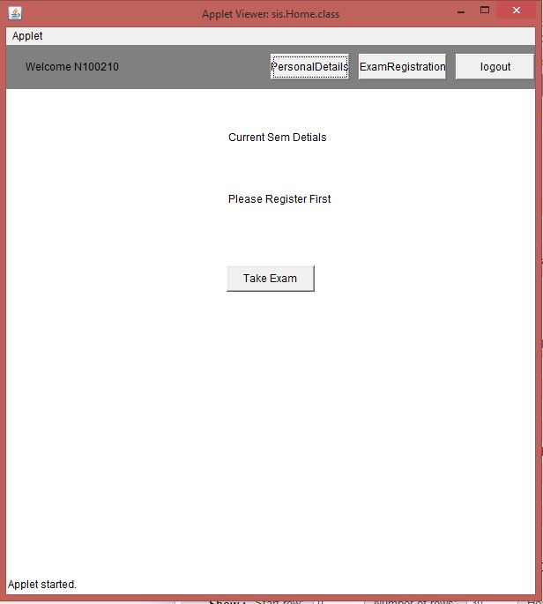
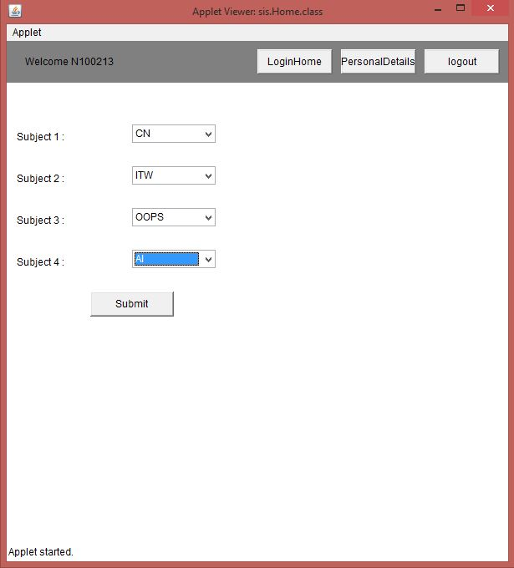
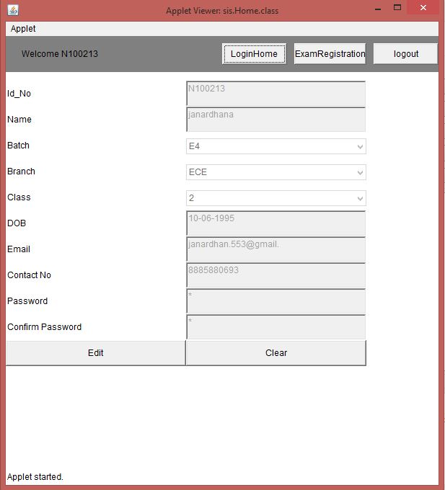
CONT…
Menu page

Slide 12
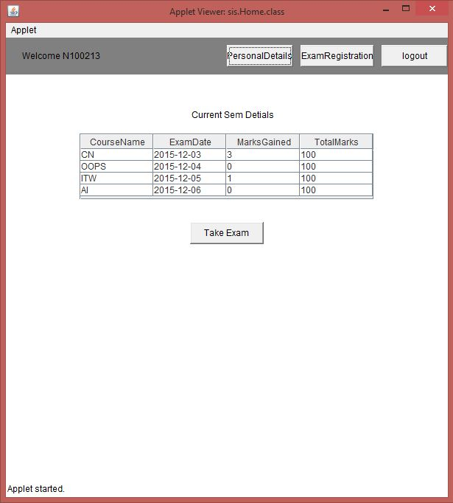
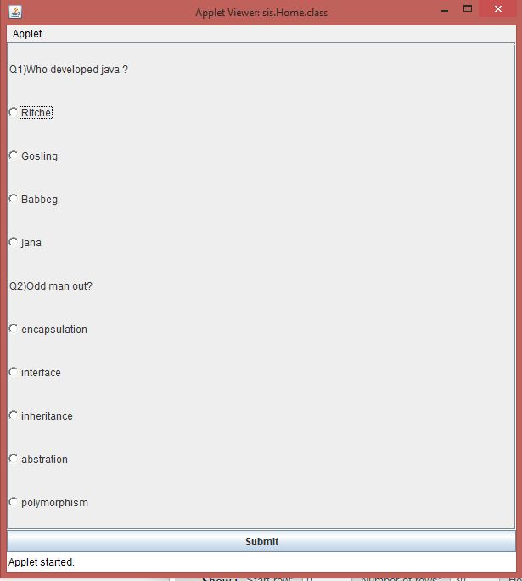
CONTD…
Take Exam

Slide 13
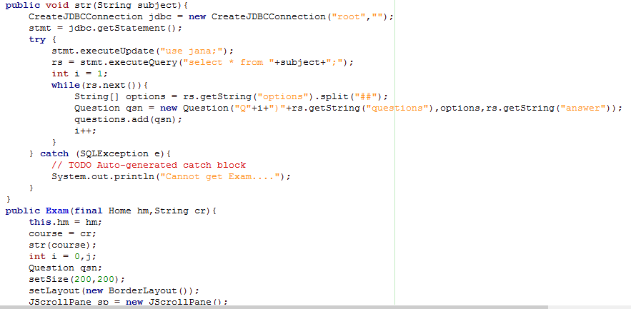
CODE IMPLEMENTATION FOR EXAM

Slide 14
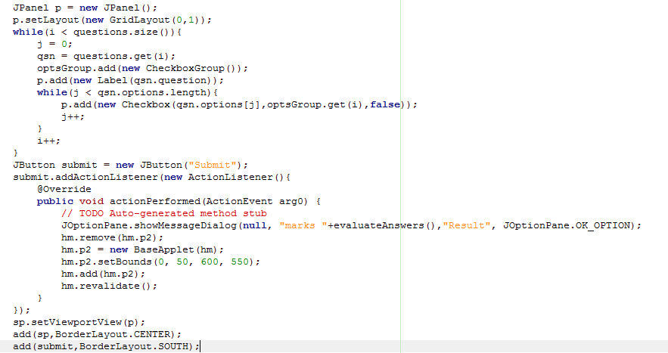
CODE IMPLEMENTATION FOR EXAM

Slide 15
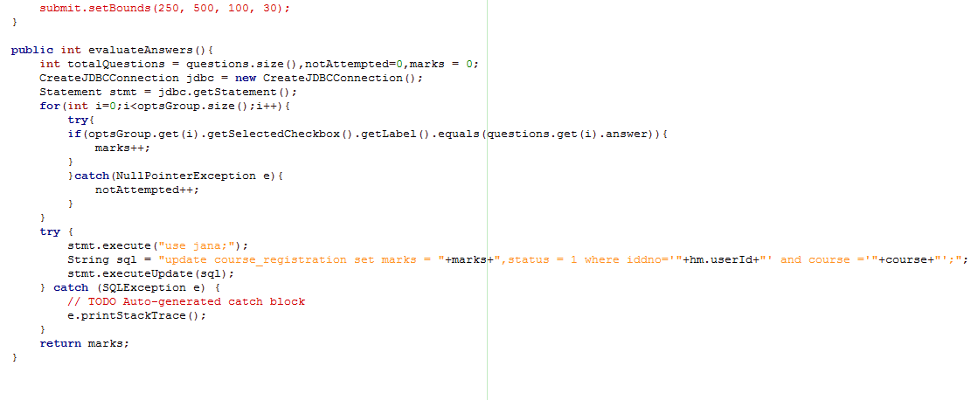
CODE IMPLEMENTATION FOR EXAM

Slide 16
Conclusion
Reduces the paper work
Reduces cost for exam conduction
Instant Results display for online exams
Student Academic Profile analysis based on statistics

Slide 17

We entertain any kind of query, comments and suggestions.....

